Slide 1
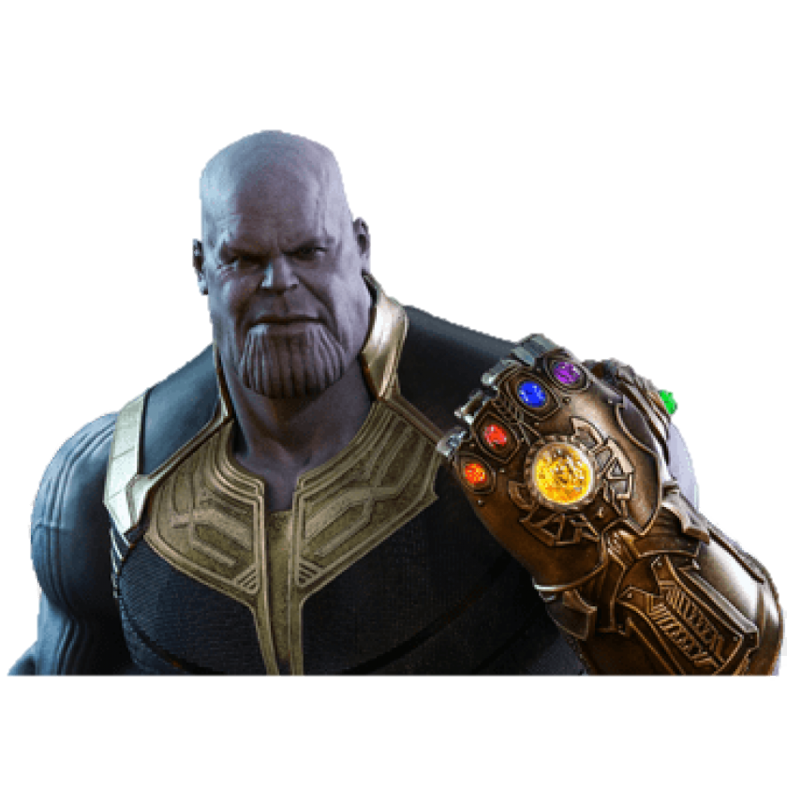
Smart Mouse Glove
Amina Gojak
Yuzhen Liu
Tong He

Slide 2
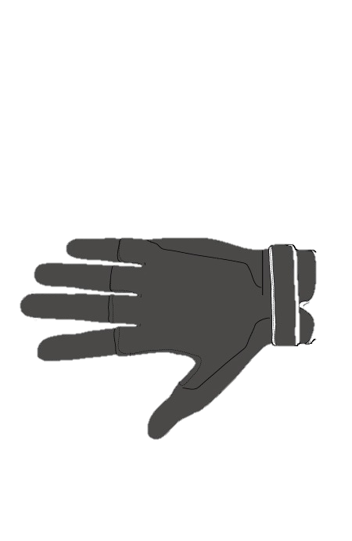

Feedback Unit (reverse side)
Structure Details
Vibrator
Flex Sensor
Power Unit
Batteries
Raspberry
Pi
Gesture Sensor
Accelerator and Gyro
Input Unit
PC
Touch buttons

